Slide 1
Nevada Next Generation 511 System
(NNG511)
Planning Began in June 2011
RFP released December 2011
NTP Issued July 25, 2012
9 months to design, test and deploy
Project Kickoff Held
August 1, 2012

Slide 2
General Goals of NNG511
Improve usability and ease for the customer
Scalable, to handle new data input as it becomes available
A one-stop-shop for multi-modal traveler information
Make use of advances in technology
Regional and statewide focused
Consider Nevada’s texting while driving ban, effective as of January 2012

Slide 3
NNG511 Presentation Overview
Project Scope
System Overview
High Level Functionality
Interactive Voice Response system (IVR)/Telephone
Web, Mobile Apps, Social Media, Alerts
CRS, Data Fusion, TMDD/C2C
Major Project Milestones/High Level Schedule
Questions

Slide 4
NNG511 Project Scope
Implement a system that maximizes the use of NDOT’s and surrounding States’ data to deliver accurate and reliable traveler information seamlessly to the public through a 511 interactive voice response (IVR) telephone service and an intuitive web site with both a statewide and regional focus.
Developed and deployed in two phases.
Develop a sophisticated IVR Telephone system.
Develop an Enhanced Interactive Web site.
Develop Data Fusion Interfaces to NV districts.

Slide 5
NNG511 Project Scope
Deliver Mobile Apps, Social Media & Alerts .
Regional Twitter Feeds
Updated automatically
Option for operators to tweet
Develop a Condition Reporting System (CRS) to enter floodgate and web banner messages that include AMBER and SILVER Alerts, major closures, statewide events, flooding, etc. Create HAR messages and have the ability to input incidents .
Develop NDOT TMDD Data Warehouse Interface - C2C (phase 2).

Slide 6
NNG511 System Overview
Major Components
Condition Reporting System
NV Data Warehouse Integration/C2C
Data Fusion
Mobile Apps, Social Media, Alerts
Interactive Web Site
Phone/IVR (Interactive Voice Response)

Slide 7
System Overview - IVR
Real-time, relevant information, including data from, incidents, closures, work zones, special events, and weather, based on Points of Interest such as cities, tunnels, bridges or other landmarks.
Route planning/travel time, including incidents along the chosen route.
Floodgate messages and Amber alerts that can play statewide or within one of the three regions within the state, and that will be configured to play at certain pre-defined points in the call flow.
Transfers to other State of Nevada transportation agencies, neighboring 511 systems, and so forth.

Slide 8
System Overview - IVR
A streamlined menu and shortcuts that allow users to get their desired information quickly.
Integration with back end to provide data.
Transfer to VoltDelta’s Survey Product (DeltaCheck) for optional caller survey function.

Slide 9
System Overview - Web
A fully functional web site that includes events, cameras, maps, and other relevant system information.
A map that is pannable, zoomable, and includes layers to access other system information such as events.
Congestion layer that shows the current roadway speed data.
Clickable icons representing incidents, construction, weather, cameras, changeable message signs, and highway advisory radio sites, Road Weather Information Sites (RWIS).
Selectable layers that allow the user to turn off any specific categories of information.
Scrolling alerts for high priority information, tailored to the location currently being viewed on the map.
Links to other 511 systems in adjoining states and other transportation resources in Nevada.
The ability to create and modify accounts that enable the user to receive traffic alerts by email or short message service (SMS) messaging.
Social Networking integration (Facebook, Twitter).

Slide 10
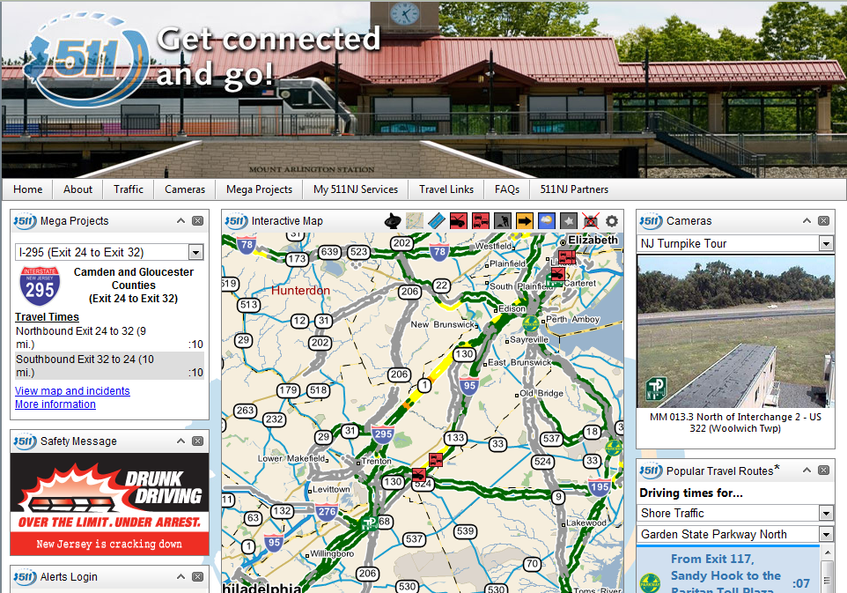
Website Features

Slide 11
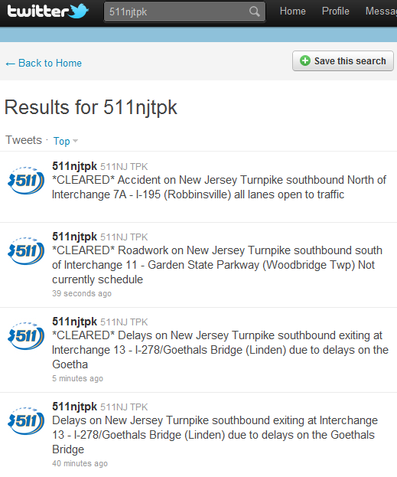
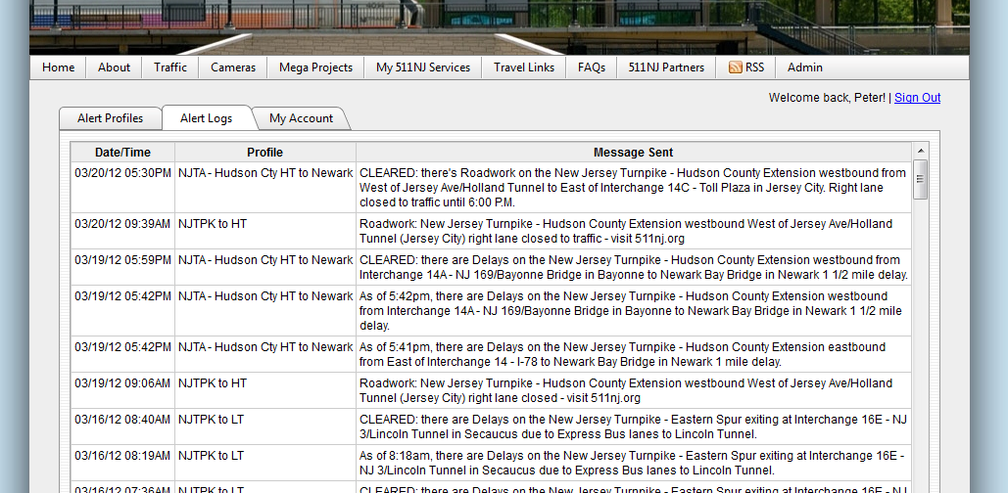
Social Media, Mobile Apps & Alerts

Slide 12
System Overview - Data Fusion
Collect data from the available sources, convert it into standardized internal formats.
Handle all roadway sensor (link) data, Events data, and weather information, as available.
Data is made available to other internal users (such as the web and IVR).
Link Data Fusion Process that can accept point (spot sensor), segment (probe), historical, and algorithmically derived data.

Slide 13
Major Project Milestones/Schedule
Kick Off Meeting - August 1, 2012
Preliminary Design Review (PDR) – October 24-25, 2012
Critical Design Review (CDR) – November 2012
Milestone Demonstration #1 – December 2013
Milestone Demonstration #2 – January 2013
Milestone Demonstration #3 – February 2013
Factory Acceptance Testing – March 2013
Start of 30 day Operational Test – March 2013
Completion of 30 day Operational Test – April 2013
NNG511 Go Live – April 2013

Slide 14
Conclusion
Questions

Slide 15
Thank You

